Slide 1

Huazhong University of Science and Technology
The Department of Electronics and Information Engineering
Electronic Circuit Analysis and Design
Electronic Circuit Analysis and Design
Dr. Tianping Deng
Email: dengtp@hust.edu.cn

Slide 2
Contents
PART 1 SEMICONDUCTOR DEVICES AND BASIC APPLICATIONS
Chapter 1 Semiconductor Materials and Diodes
Chapter 2 Diode Circuits
Chapter 3 The Field-Effect Transistor
Chapter 4 Basic FET Amplifiers
Chapter 5 The Bipolar Junction Transistor
Chapter 6 Basic BJT Amplifiers
Chapter 7 Frequency Response
Chapter 8 Output Stages and Power Amplifiers
PART 2 ANALOG ELECTRONICS
Chapter 9 Ideal Operational Amplifiers and Op-Amp Circuits
Chapter 10 Integrated Circuit Biasing and Active Loads
Chapter 11 Differential and Multistage Amplifiers
Chapter 12 Feedback and Stability
Chapter 13 Operational Amplifier Circuits
Chapter 14 Nonideal Effects in Operational Amplifier Circuits
Chapter 15 Applications and Design of Integrated Circuits
Chapter 4 Basic FET Amplifiers

Slide 3
Ch4 Basic FET Amplifiers
4.1 The MOSFET Amplifier
4.2 Basic Transistor Amplifier Configurations
4.3 The Common Source Amplifier
4.4 The Common Drain（Source Follower） Amplifier
4.5 The Common Gate Configuration
4.5.1 Small voltage and current gains
4.5.2 Input and output Impedance
4.6 The Three Basic Amplifier Configuration:
Summary and comparison

Slide 4
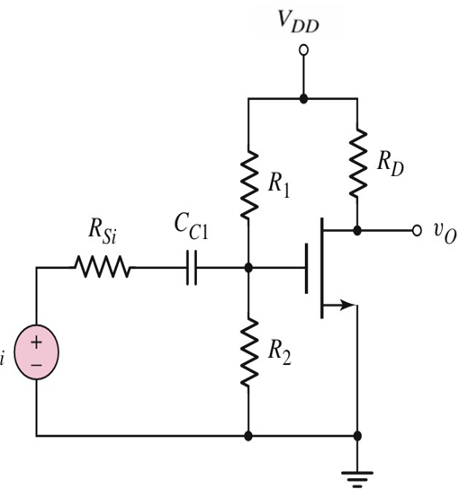
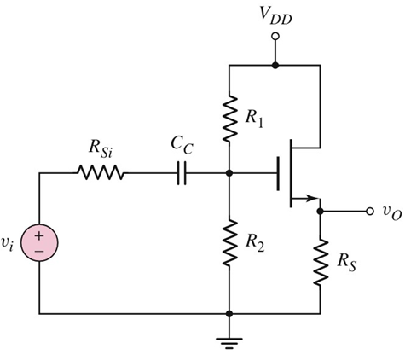
Review

Slide 5
Ch4 Basic FET Amplifiers
4.1 The MOSFET Amplifier
4.2 Basic Transistor Amplifier Configurations
4.3 The Common Source Amplifier
4.4 The Common Drain（Source Follower） Amplifier
4.4.1 Small-signal voltage gain
4.4.2 Input and Output Impedance

Slide 6
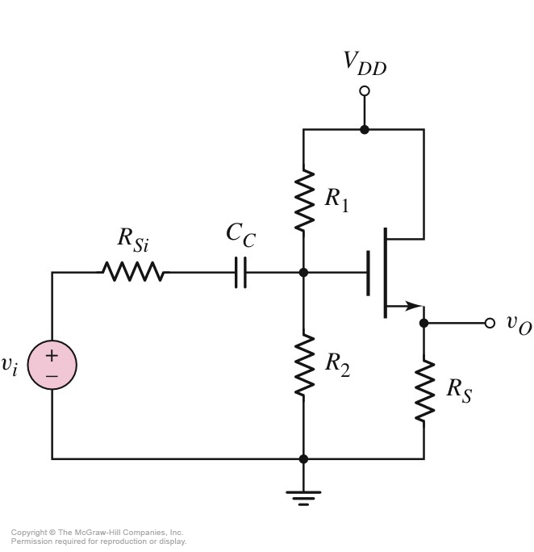
4.4 The Common Drain（Source Follower） Amplifier
CD
Source Follower

Slide 7

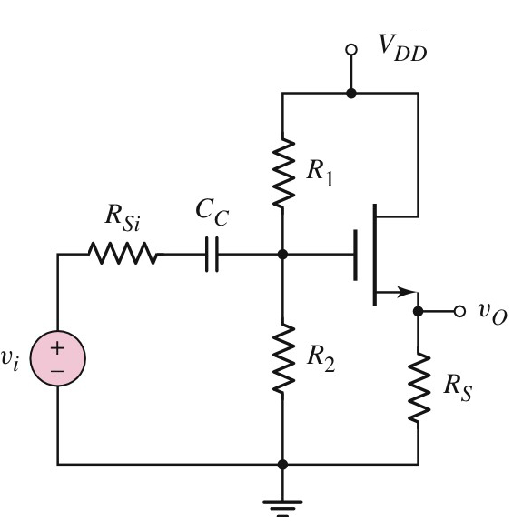
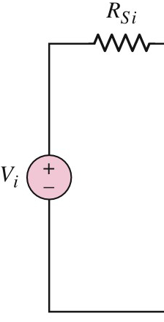
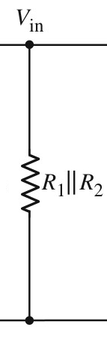
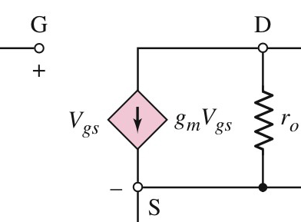

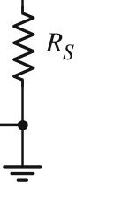
4.4.1 Small-signal voltage gain
Small-Signal Equivalent Circuit

Slide 8
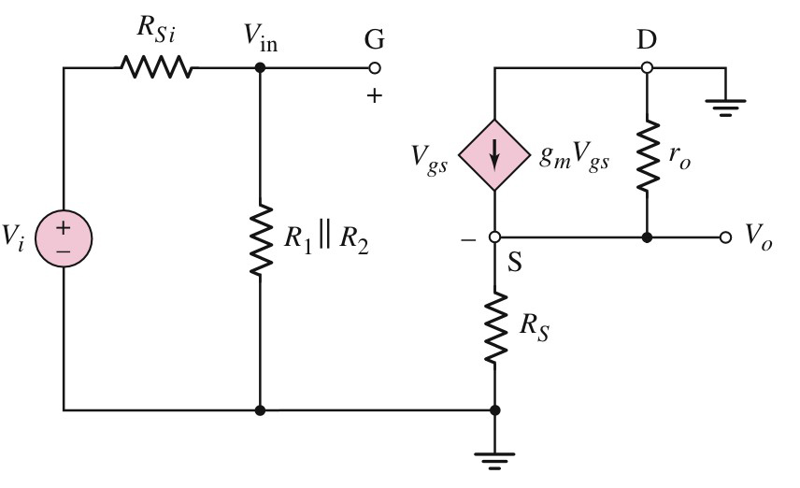
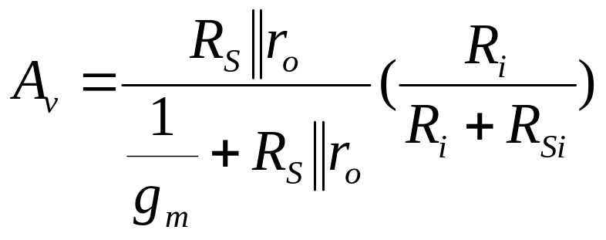
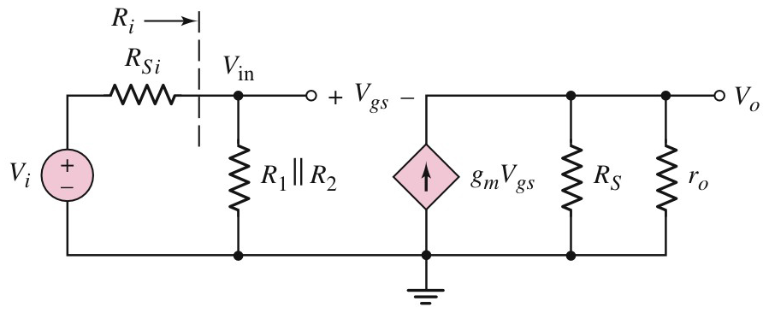
4.4.1 Small-signal voltage gain
V_{o} =g_{m} •V_{gs} •(R_{S}// r_{o})
V_{in} = V_{gs} + V_{O}=V_{gs} + g_{m} •V_{gs} •(R_{S}// r_{o})

Slide 9
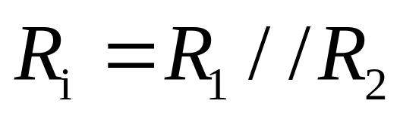
4.4.2 Input and Output Impedance

Slide 10
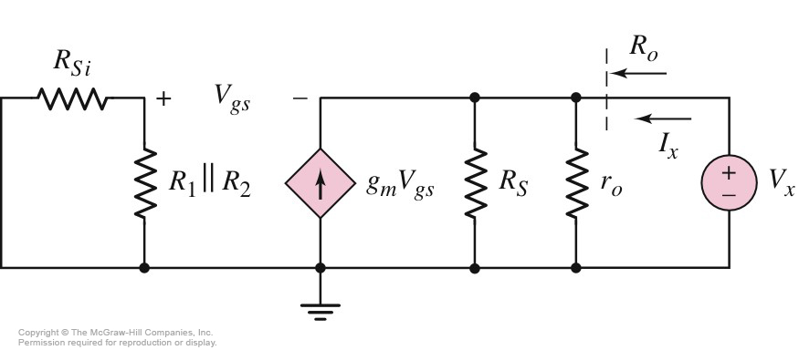
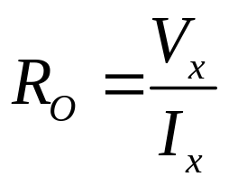
4.4.2 Input and Output Impedance
Set
zero

Slide 11
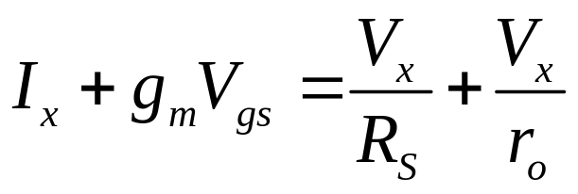
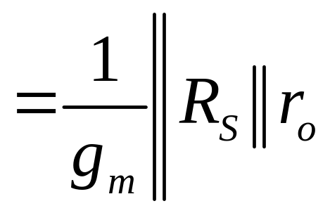
4.4.2 Input and Output Impedance
Output Resistance is very low.
Without significant loading effects.

Slide 12
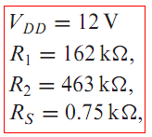



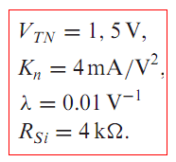



Slide 13
Questions
and
Answers

